Slide 1


Monthly Update
Irrigation Efficiency Study and Farm Assessments
August 18, 2024

Slide 2
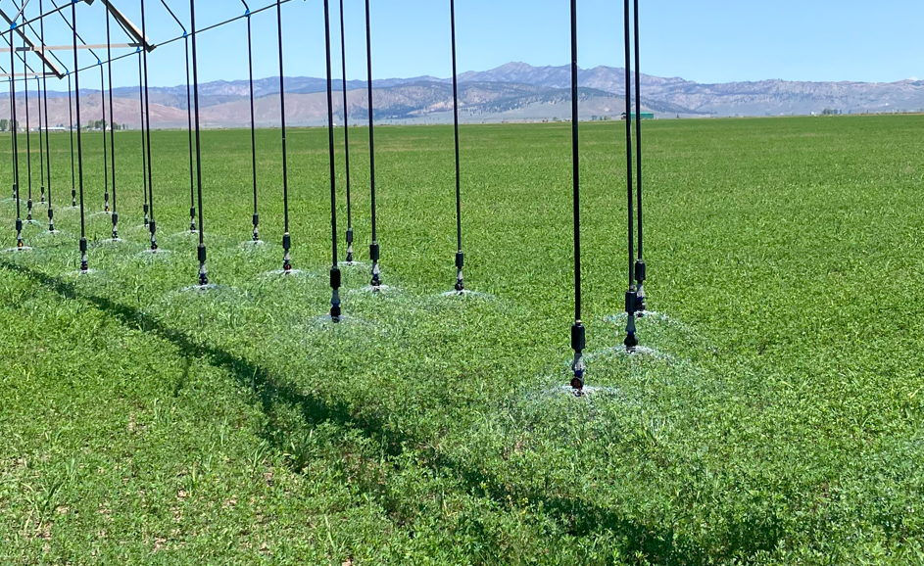
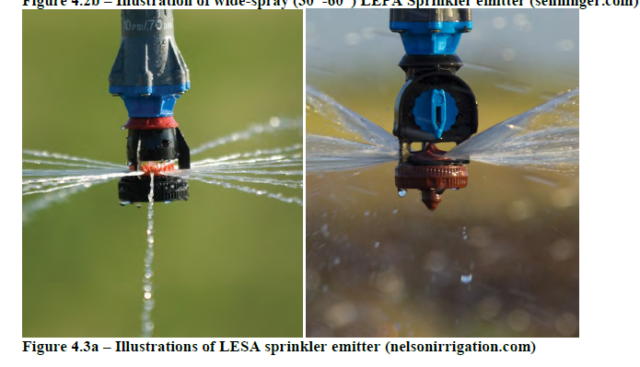
Existing LESA/LEPA Systems in Sierra Valley
LESA Sprinkler Heads at Roberti Pivot 13
Majority are Nelson LESA heads
Observed 1 Senninger LEPA Head
LESA Sprinkler Heads at Goodwin
Senninger LESA heads
LESA Sprinkler Heads at Grandi Span 6
Senninger Spray heads
LESA/LEPA Sprinkler Heads at Green Gulch
Unknown Spray heads

Slide 3
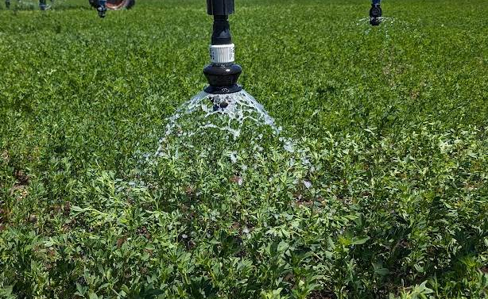
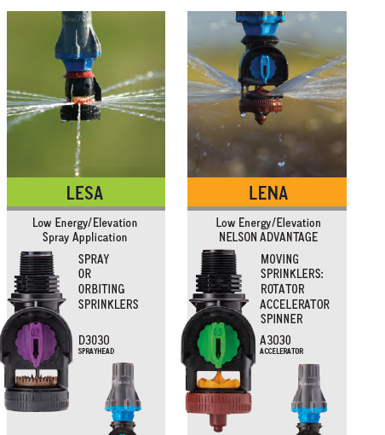
LEPA vs. LESA
The LEPA system dribbles water directly onto the soil surface. Delivers water to soil more quickly to reduce foliage interception.
LEPA
LEPA – Low Elevation Precision Application
Higher Efficiency than LESA due to less wetted soil surface
Max field slope is 1%
Lateral application limitation – requires slower pivot rotation to fill soil profile
Not good for shallow rooted crops (i.e. grasses)
6-20 psi operation pressure results in energy savings
Less Wheel Track issues

Slide 4
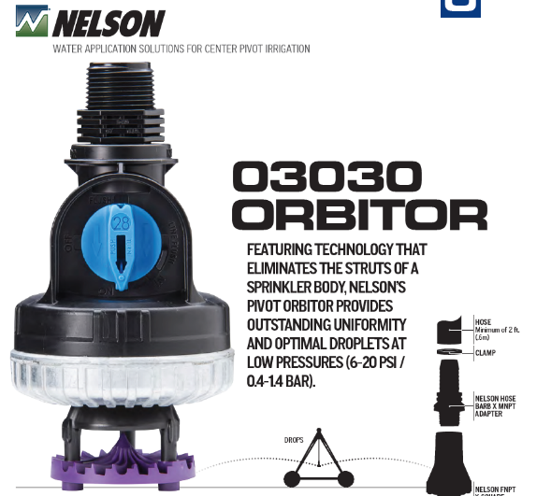
LEPA vs. LESA
LEPA
The LESA system applies water in small droplets, wider dispersion than LEPA and more foliage interception
LESA – Low Energy Spray Application
Spray application vs. LEPA bubbler
Max field slope >1%
Lateral application limitation – requires slower pivot rotation to fill soil profile
Wobbler/Orbitors have larger droplets, installed at LESA height, and results in less foliage interception than LESA.
Orbitors have lower specification for pressure (6-20 psi) resulting in 36-60 feet of coverage

Slide 5
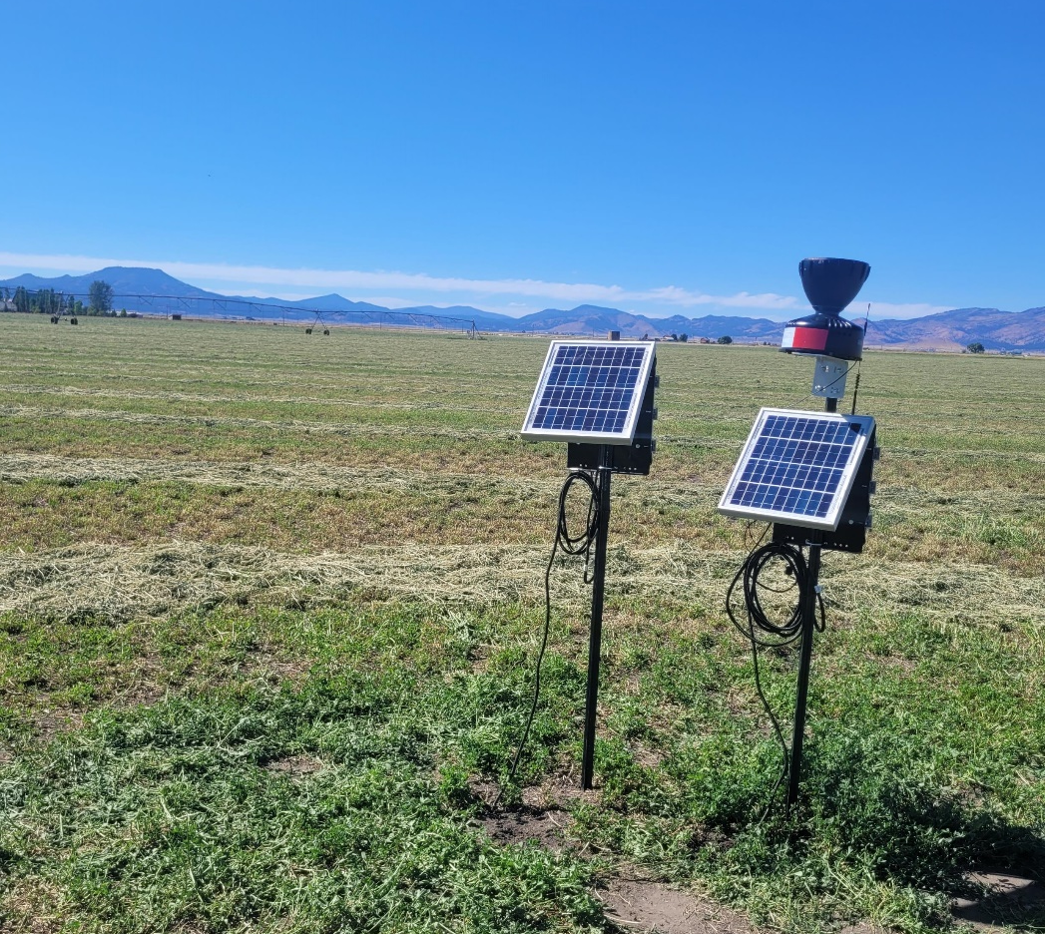
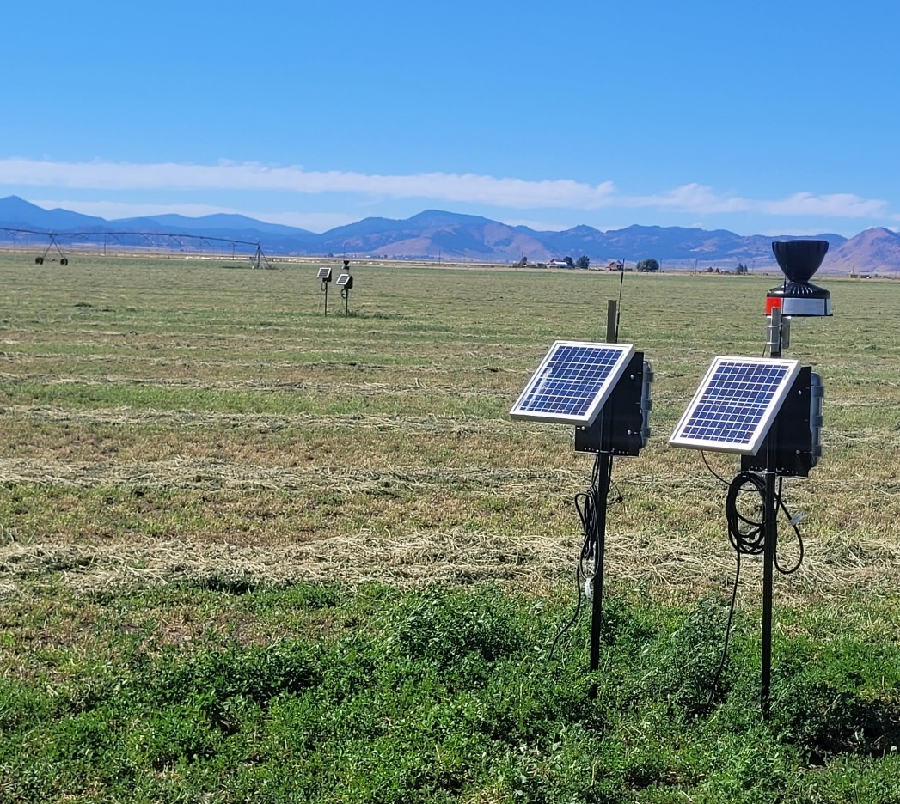
Soil Moisture Meters at Grandi Span 6

Slide 6
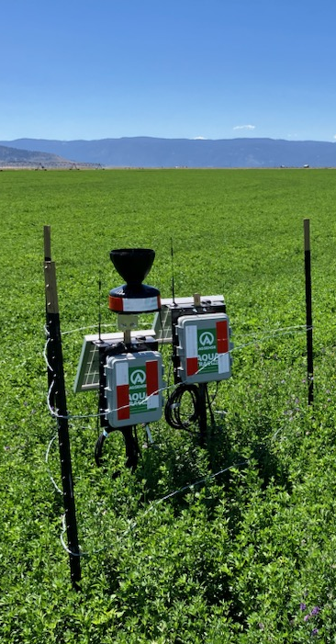
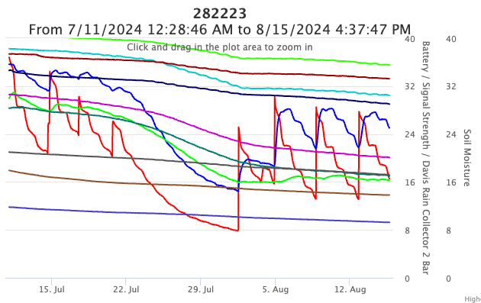
Initial Data from 0 to 48” Soil
Moisture Probe
Roberti Pivot 13
4-inch
8-inch
12-inch
48-inch

Slide 7
Soil Moisture Sensors/Stations
1 Station = two sensors placed at 0-4 feet deep and 4-8 feet deep with sensors located every 4 inches = 24 sensors per Station
Eight Soil Moisture Stations (Completed – DWR Grant)
  Two Stations in Pivot 10 – Reference
  Two Stations in Pivot 13 – LESA
  Two Stations in Grandi Pivot – Reference
  Two Stations in Grandi Pivot – LESA
Four Soil Moisture Stations (Future – Plumas Grant)
  Two Stations in Pivot 2 – LESA (Existing System)
  Two Stations in Grandi Pivot – LESA (Future System)
Two Soil Moisture Stations for LEPA (Future)
  Discussion

Slide 8
Plumas County Grant Task 7
Task 7 will involve the conversion of conventional MESA systems to LEP A systems and LESA equipment with the flexibility of including multiple options, as described below.
First, collaboration with willing ranchers and 2 volunteer farmers on 2 center pivot fields and 1 additional baseline fields to convert 1 conventional MESA systems to LEP A systems, which release a reduced volume of water closer to crop level in an effort to reduce water loss from evaporation and wind drift and reduce overall energy and pumping required for irrigation. LEPA implementation will require the installation of 5 flow meters at pivot heads and 5 soil moisture systems, to evaluate both pivot water use and soil moisture before and after system conversion.

Slide 9
Plumas County Grant Task 7 (continued)
In addition to the LEPA demonstration, this project will also convert 2 additional center pivots from the MESA systems to LESA equipment, in order to assess the efficiency of LESA in improving agricultural irrigation relative to one baseline field. LESA applies water more uniformly than LEPA (Peters et al., 2016)1, and may have different benefits or drawbacks that will be assessed for the northeast region of the Sierra Valley. LESA demonstration will require 1 to 2 volunteer farms, and installation of 2 LESA systems, 3 flow meters and 3 soil moisture systems.
Deliverables for Task 7 will include a compilation of monitoring data, before and after LEP A and LESA conversions, for the annual irrigation report detailed in Task 2. The budget for Task 7 is $170,000, based on the cost for 1 LEPA conversions and 1 LESA conversion.

